Slide 1
Classifying leaf diseases
using Artificial Neural Networks
by Abhishek Malpotra Siddharth Naidu

Slide 2
Agenda
Data Exploration
Real-life Use-cases
Modelling
Deployment
Q&A!
Model Evaluation
Challenges & Limitations
Introduction
Data Preparation
Conclusion

Slide 3
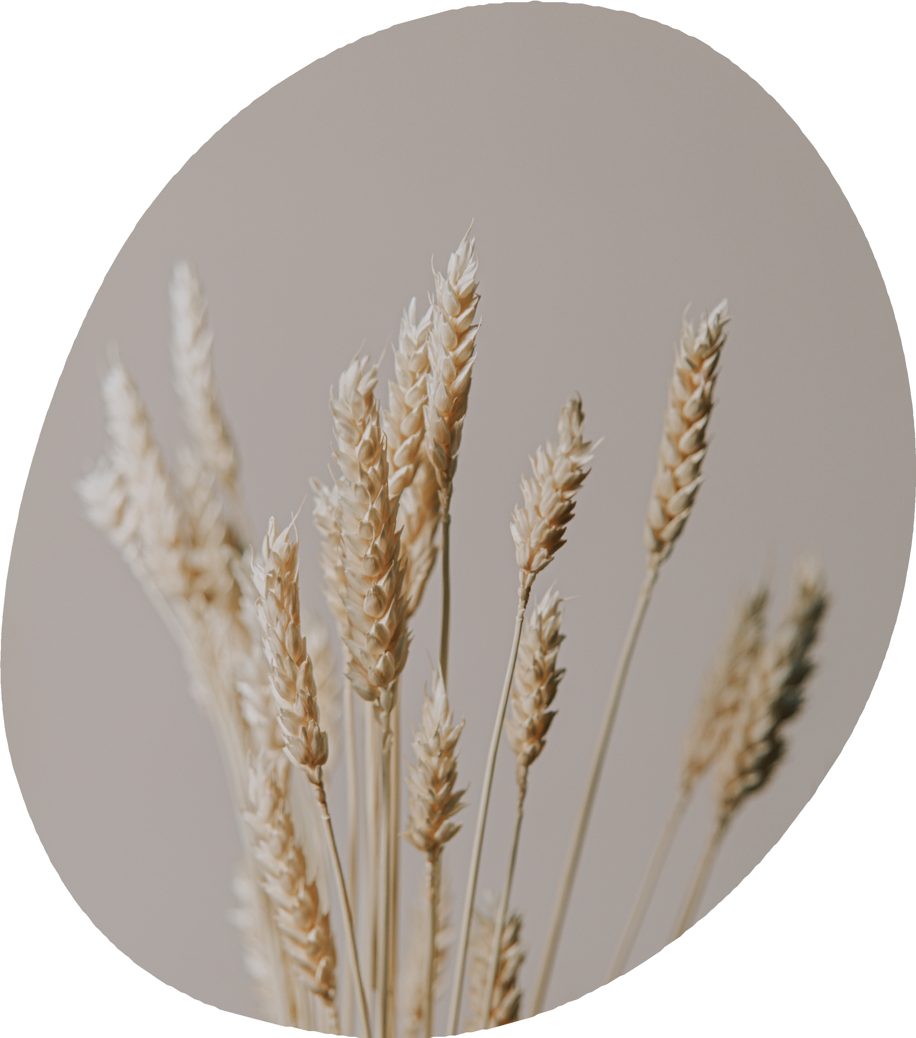
Introduction
The objective of this project is to develop an AI and ML-based system for accurate identification and classification of leaf diseases through image processing techniques. The system aims to analyze plant images and symptoms to detect and diagnose diseases, enabling farmers to take appropriate measures for disease prevention and management, ultimately ensuring healthy crop yields.

Slide 4
Data Exploration
GO BACK TO AGENDA PAGE

Slide 5
Statistical exploration
We performed basic statistical exploratory analysis after loading & unzipping the data using Kaggle's API
Data Classes
38
Trainning Data
70295 images
Validation Data
17572 images
Data Shape
(224, 224, 3)
Data source link - Kaggle

Slide 6
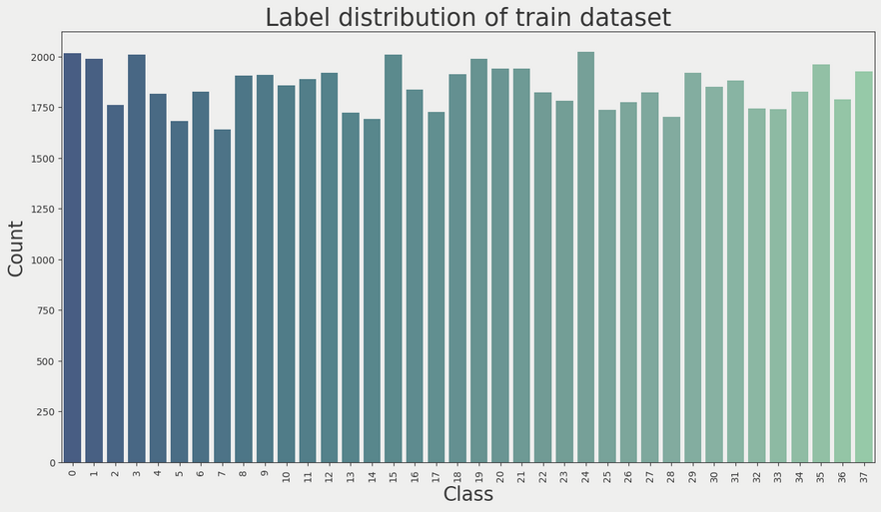

Visualizations
We plotted a few graphs as described below
Countplot of labels- Training data
To check for imbalances
Countplot of labels- Validation data
To check for imbalances

Slide 7

Data Preparation
Defined Constants
Image & Batch size Number of Epochs,
Train & Validation folders Model path
Data Augmentation
Increased the diversity of the dataset
Data Loading
Training set Validation set

Slide 8
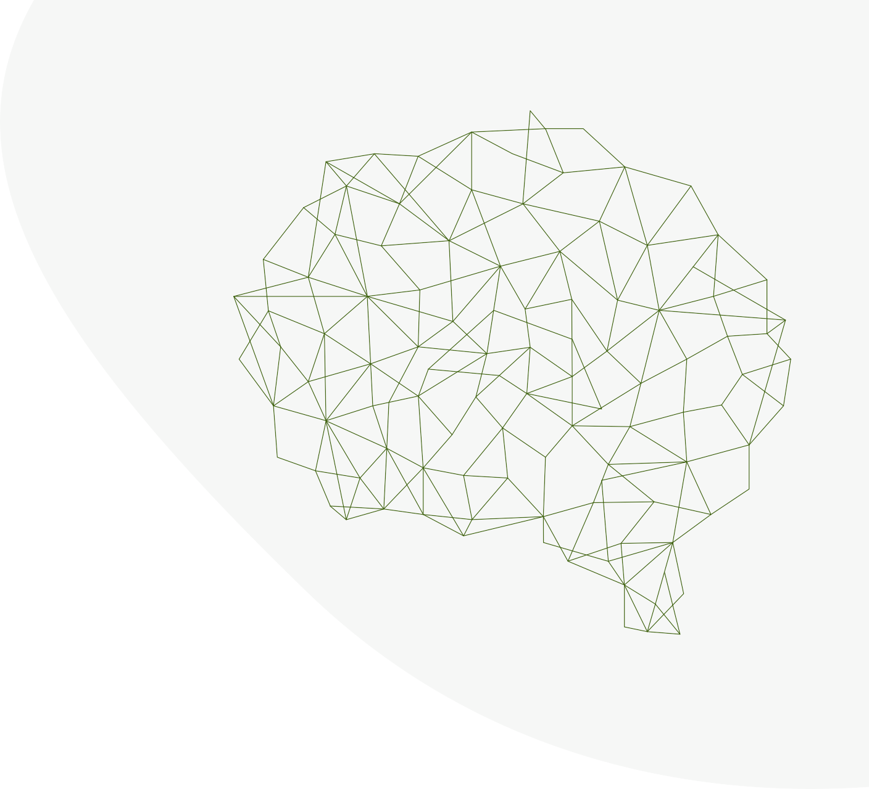
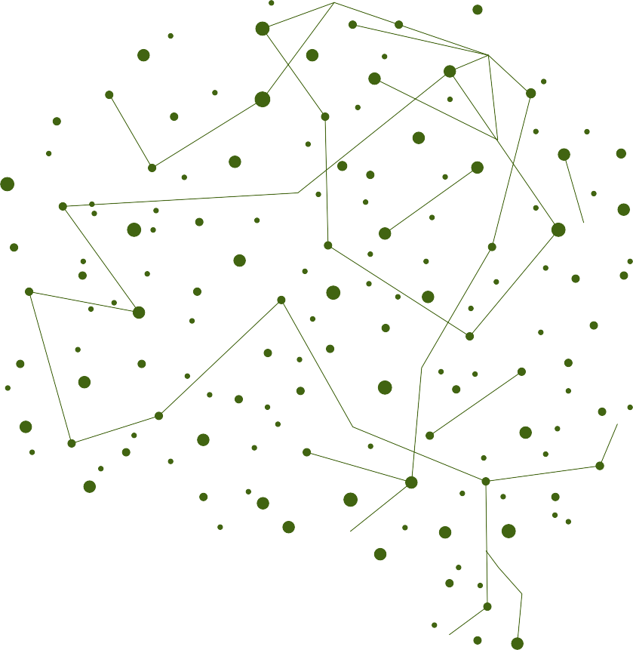



Modelling
We chose a Deep Learning Neural Network to train our model. Since neural networks learn complex features and patterns from images, making them adept at recognizing and categorizing images with high accuracy.
CNN Model
MobileNetV2 architecture
Weights are defaulted to pre-trained values include_top = False
images are represented via RGB channels
Setting parameters
False - Ability to train the pre-trained model
Creating additional layers of average pooling layer, dropout and dense layers
Finalize model
Combine pre-trained model for feature extracting & additional layers for classification
Compile model

Slide 9
Model Evaluation
LOSS
ACCURACY
50
40
30
20
10
0
Epoch 1
Epoch 2
Epoch 3
Epoch 4
Epoch 5

Slide 10
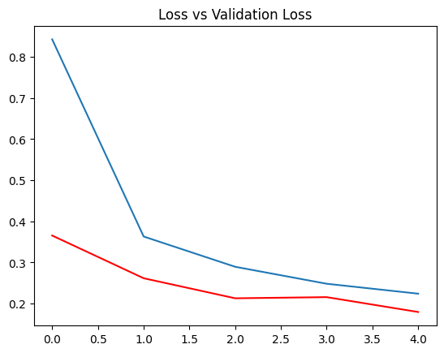
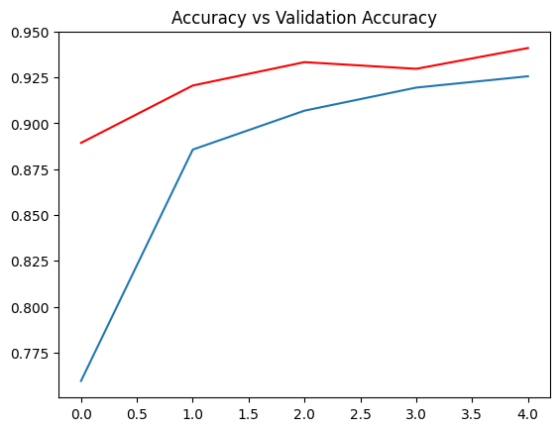
From the graphs below you can see a significant decrease in loss across the epochs and similarly an increase in prediction accuracy across epochs
Loss across Epochs
Accuracy across epochs

Slide 11
Conclusion
An AI and ML-based system can be developed and trained to accurately identify and classify plant diseases through image processing techniques. With a reported accuracy of 95%, this system could potentially aid farmers in detecting and diagnosing diseases in plants more quickly and accurately, enabling them to take appropriate measures for disease prevention and management, ultimately ensuring healthy crop yields.
Overall, the project demonstrates the potential for AI and ML-based systems to improve disease detection and management in agriculture, leading to better crop yields and more sustainable farming practices.

Slide 12





Use-Cases
Precision farming
By using the AI and ML-based system to analyze plant images and symptoms, farmers can identify specific areas of the farm that are affected by diseases, allowing them to apply targeted treatments only where they are needed.
Disease monitoring
The AI and ML-based system can be used to continuously monitor crops and detect early signs of diseases, allowing farmers to take proactive measures to prevent or manage diseases before they become widespread.
Early detection & prevention
By using the AI and ML-based system to identify diseases in plants, farmers can take timely and appropriate measures to prevent the spread of diseases, minimizing crop damage and losses.

Slide 13
Challenges & Limitations
Data Quality
Data used for this set might not yield in optimal performance for plant species across he world
Overfitting
Overfitting can limit performance on new data.
Transparency
Interpretability can be challenging due to the complexity of deep learning models.

Slide 14
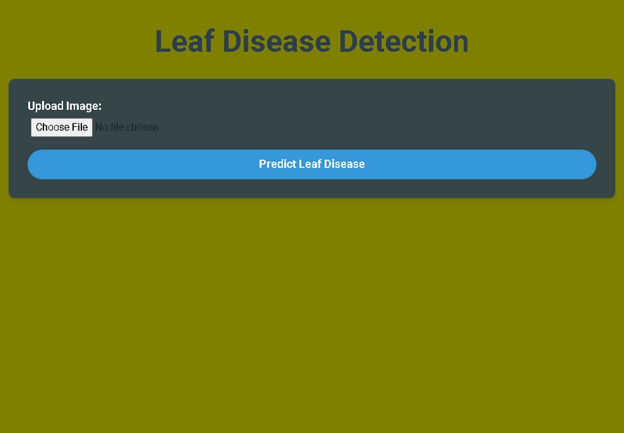
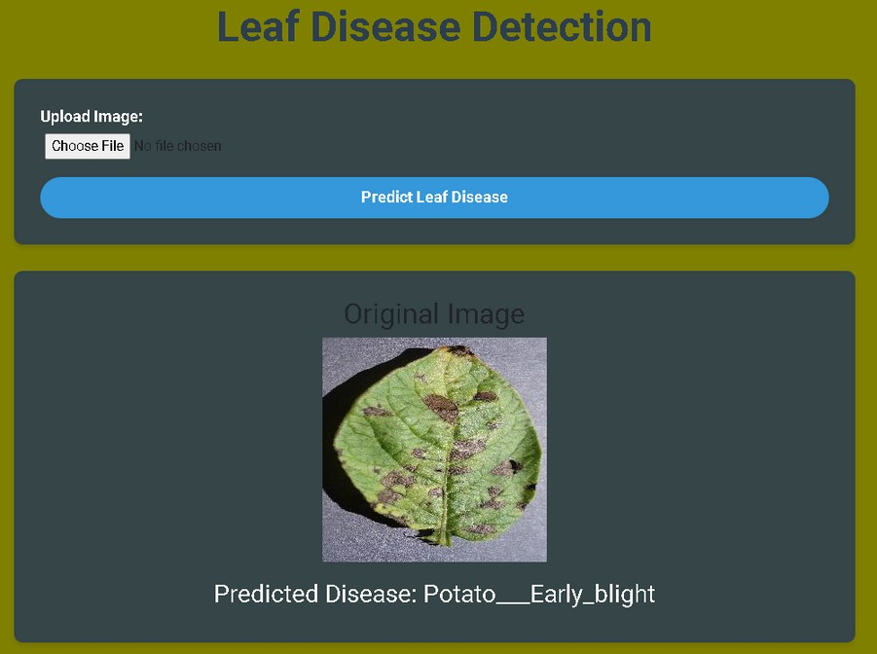
Deployment
For the deployment phase of the leaf disease detection project, we employed the Flask web framework to design a user-friendly interface for our application.
As you can see, we uploaded an image and the flask application responded with the leaf disease

Slide 15
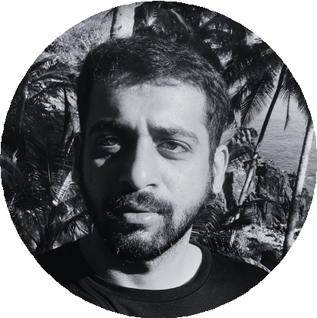
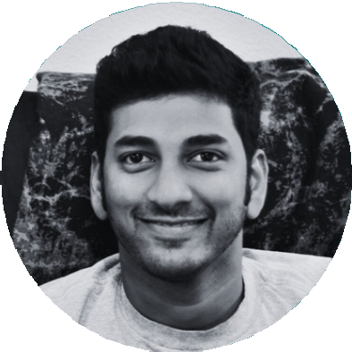
Q&A, ask away!
Abhishek Malpotra
Siddharth Naidu

